Slide 1
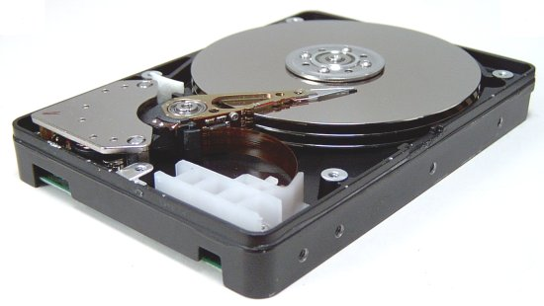
CSE360-Computer Interfacing BRAC University Magnetic Disk

Slide 2
Magnetic Disk
A magnetic disk is the primary storage disk in a computer.
• A magnetic disk is a used to read from and write data to the disk.
• The data on a magnetic disk are read and written using a magnetization process.
• It is covered with a magnetic coating and stores data in the form of tracks and sectors.
Physically a magnetic disk is a thin, circular plate or platter made of metal or plastic that is usually coated on both sides with a magnetizable recording material such as Iron Oxide. It is called substrate.

Slide 3
Magnetic Disk
The disk is stored in a specially designed protective envelop or cartridge, or several of them are stacked together in a sealed, contamination-free container.
Hard disks, zip disks and floppy disks are common examples of magnetic disks.

Slide 4
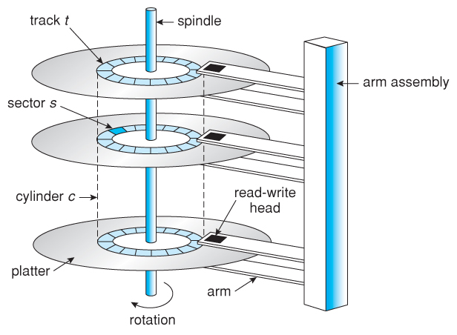
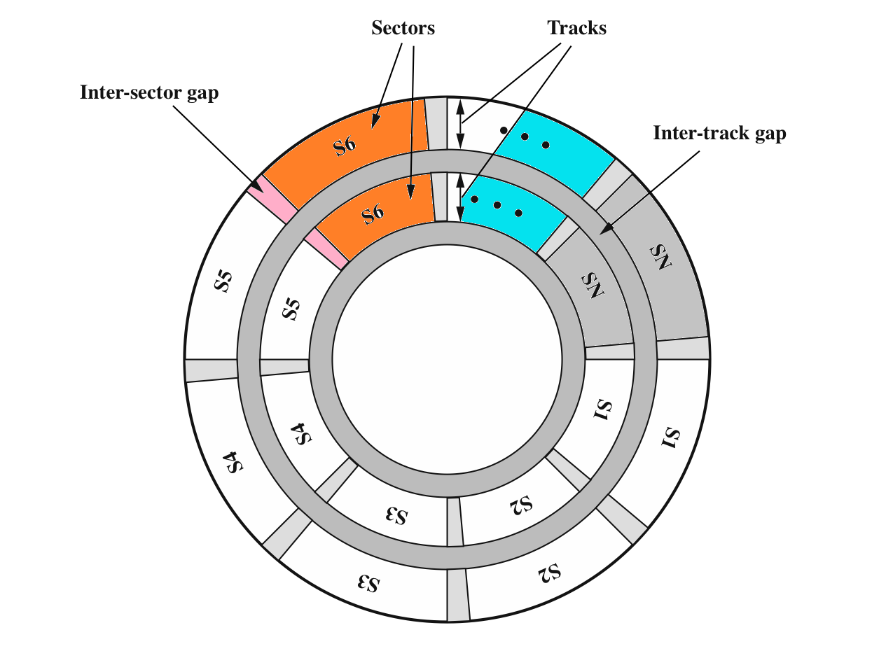
Magnetic Disk

Slide 5
Magnetic Disk
TRACK:-
The disk surface is divided into concentric tracks (circles within circles).
The thinner the tracks, the more storage.
The data bits are recorded as tiny magnetic spots on the tracks. The smaller the spot, the more bits per inch and the greater the storage.
SECTOR:-
Tracks are further divided into sectors, which hold a block of data that is read or written at one time.
In order to update the disk, one or more sectors are read into the computer, changed and written back to disk. The operating system figures out how to fit data into these fixed spaces.

Slide 6
Magnetic Read and Write Memory
The write mechanism the electricity flowing through a coil produces a magnetic field.
Electric pulses are send to the write head and the resulting magnetic patterns are recorded on the surface below, with different patterns for positive and negative currents.
The read mechanism exploits the fact that a magnetic field moving relative to a coil produces an electrical current in the coil.
When the surface of the disk passes under the head, it generates a current of the same polarity as the one already recorded.
The read head consists of a partially shielded magneto resistive (MR) sensor.
The MR material has an electrical resistance that depends on the direction of the magnetization of the medium moving under it.

Slide 7
Magnetic Disk
Some key Concept:
Outcome:
Total
Partial
Total Failure
Storage Unit:
Allocation Unit

Slide 8
Timings in Operation
Disk Access Time: It is the interval between a computer makes a request for transfer of data from a disk system to the primary storage and the instant the operation is completed. Disk Access Time depends on the following three parameters:
Seek Time: It is the time required to position the read/write head over the desired track, as soon as a read/ write command is received by disk unit.
Latency: It is the time required to spin the desired sector under the read/write head, once the read/write is positioned on the desired track.
Transfer rate: It is the rate at which data are read/written to the disk, once the read/write head is positioned over the desired track.

Slide 9
Disk Partition
Logical Partition: A disk can be partitioned into multiple drives. We can partition our disk space into multiple drives and this is called as logical partition.
Physical Partition: When we will have multiple disks operating in a same system then it will be called as physical partition.

Slide 10
Bad Sector
If for some reason magnetic particles of the disk lost their magnetic property, when we will write or read data from there, they will not be affected by magnetic fields. IF the magnetic particle of disk surface lost its magnetic property, then we can not affect its alignment north- south or south – north. Then it will form bad- sector.
Reason of bad-sector:
Spark is taken place on room
Dropping the hard-disk from your hand on the floor
hammering on the disk
- in all these cases, the disk can get hurt can be affected and for the reason magnetic property can be lost.

Slide 11
Advantages
Very fast access to data.
Data can be read directly from any part of the hard disc.
In most of the magnetic storage devices the acces speed is about 1000kb/s
Some of the magnetic storage devices are very cheap for example floppy disks.
Most of the magnetic storage devices store very large amounts of data.

Slide 12
Disadvantages
Data can be altered by magnetic fields, dust, mechanical problems
Gradually lose their charge over time - data lost
Hard disks eventually fail which stops the computer from working.
Regular crashes can damage the surface of the disk, leading to loss of data in that sector.

Slide 13
.
Thank You For Your Attention

